Slide 1
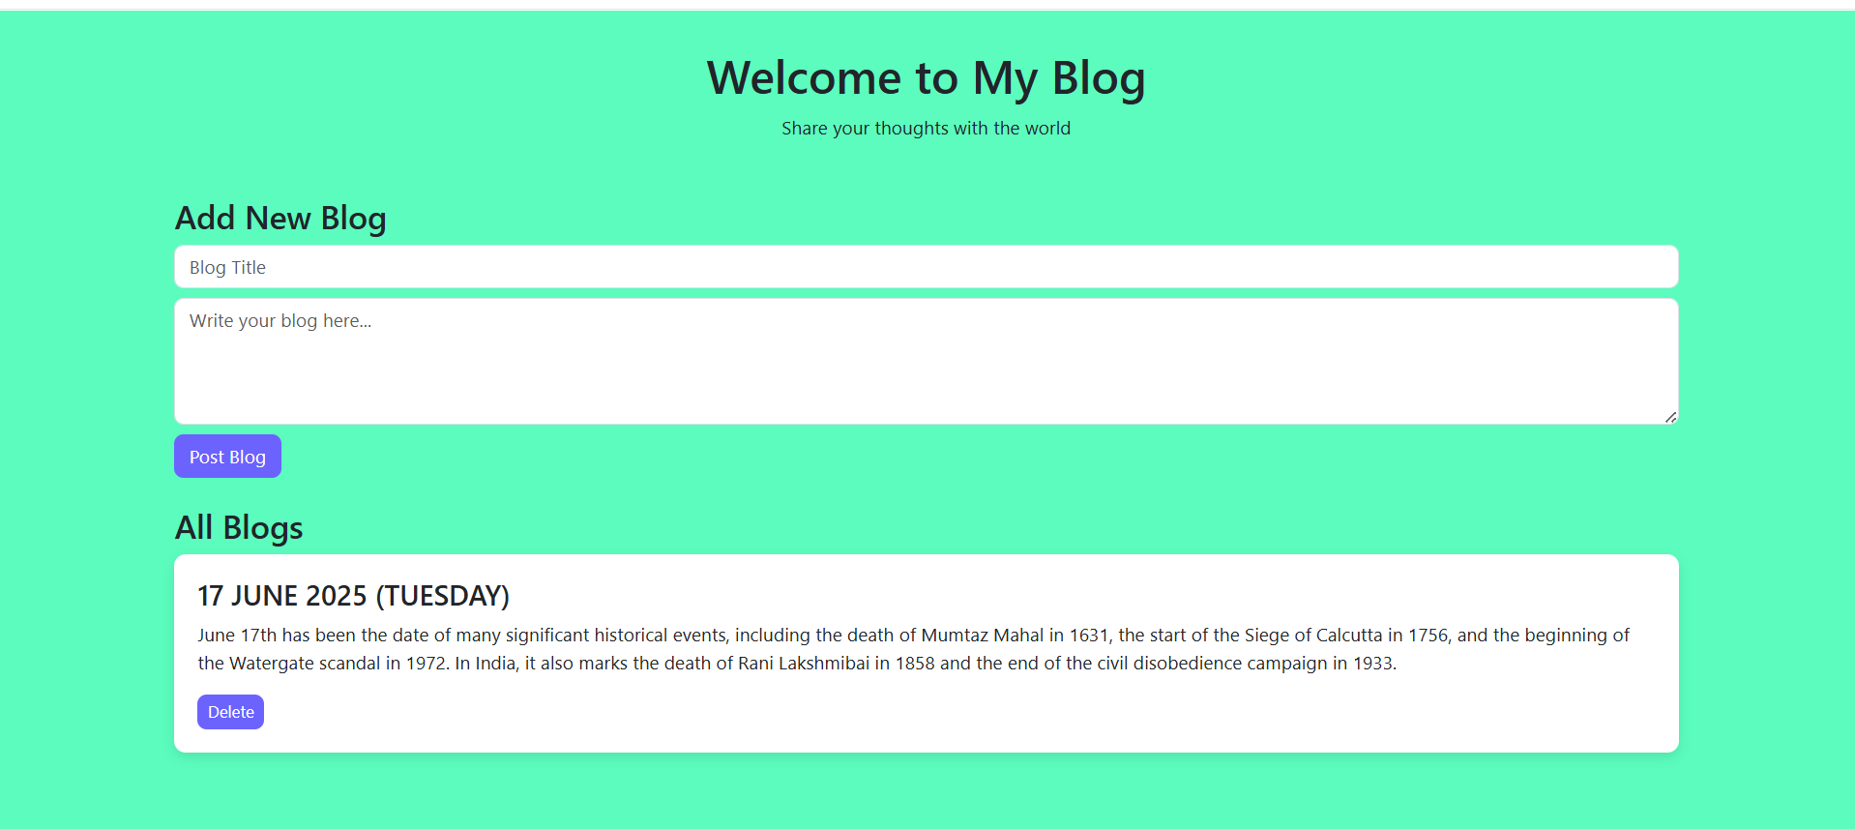
BLOG PLATFORM USING HTML &CSS

Slide 2
INTRODUCTION
A Blog platform is a web-based application where users can create, publish, and manage articles or blog posts.
Essentially it’s a space for individuals or organizations to share their thoughts ,knowledge, experiences, and opinions with the world in a structured format.

Slide 3
WORKING
Frontend:
HTML, CSS, JavaScript for User Interface
User can view, submit, delete, and navigate blogs
Backend:
CRUD Operations (Create, Read, Update, Delete)
Workflow:
User visits website
Reads or submits blogs
Admin moderates content

Slide 4
USES
Personal diaries / journaling
Knowledge sharing platforms
News & media websites
Business promotions
Educational content delivery

Slide 5
ADVANTAGES & DISADVANTAGES
Advantages:
Easy to build and use
Enhances writing and communication skills
SEO (Search Engine Optimization) friendly
Can integrate with social media for a wider audience
Disadvantages:
Requires regular content updates
Security concerns (spamming, data leaks) if not properly secured
May need backend hosting (extra cost if scaled)

Slide 6
FUTURE SCOPE
It can be beneficial with people with same hobbies and interests to interact with each other.
Integration with AI tools for writing assistance.
Adding comment section for better interaction.
Implementing user profiles and subscriptions.
Adding themes and customization options.
Monetization through advertisements or premium content.

